Slide 1
URBANPULSE AI
Smart City Traffic Intelligence Platform
Project Guide:
Prof. Puttaswamy B S Assistant Professor Department Of Computer Science
& Business Systems
Team Members:
AISHWARYA SHASTRI[4PS23CB002]
ASHUTOSH RAJ[4PS23CB005]
CHARAN B[4PS23CB008]
DIYA GOWDA S S[4PS23CB403]

Slide 2
Problem Statement
Traffic congestion is a major urban issue.
Existing systems have limited prediction accuracy.
Large-scale traffic data is difficult to process.
Privacy of mobility data is at risk.
Need a scalable and secure prediction system.

Slide 3
Objectives
Develop a Graph Neural Network model.
Predict traffic speed and volume.
Detect congestion in real time.
Ensure privacy using Federated Learning.
Apply Differential Privacy techniques.
Provide visualization through dashboard.

Slide 4
System Requirements
Software
Python
PyTorch
PyTorch Geometric
FastAPI
React.js
PostgreSQL
Hardware
Intel i5 / Ryzen 5
16 GB RAM
50 GB Storage

Slide 5
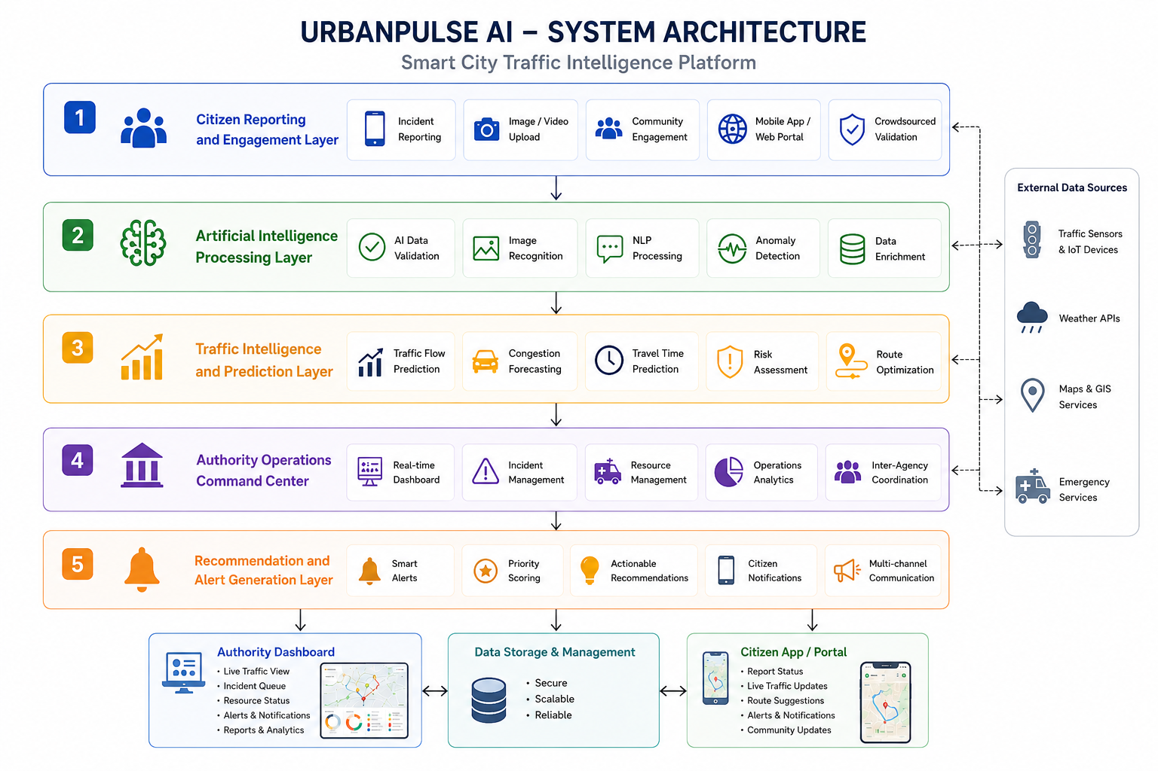
SYSTEM ARCHITECTURE

Slide 6
Methodology
Data Collection
Data Preprocessing
Validate reports using AI models
Analyze predicted traffic impact severity
Prioritize incidents using risk intelligence
Dashboard Visualization

Slide 7
IMPLEMENTATION DETAILS
Modern React frontend architecture
Scalable Node.js service layer
OpenStreetMap geospatial intelligence integration
Weather intelligence API connectivity
AI-driven analytical workflow implementation

Slide 8
Results and Outcomes
Accelerated incident assessment workflows
Reduced manual verification dependency
Enhanced traffic situational awareness
Improved authority response preparedness
Strengthened smart city intelligence capabilities

Slide 9
Conclusion & Future Enhancements
Unified urban intelligence management platform
Bridging citizens and city authorities
Leveraging AI for informed decisions
Real-time government traffic data integration
Advanced graph neural network predictions
Scalable deployment across multiple cities

Slide 10
THANK YOU!

